Slide 1
Sleep Study
Agniva G, Lere O, Pradeep P, Ashrit K

Slide 2
Background

Slide 3
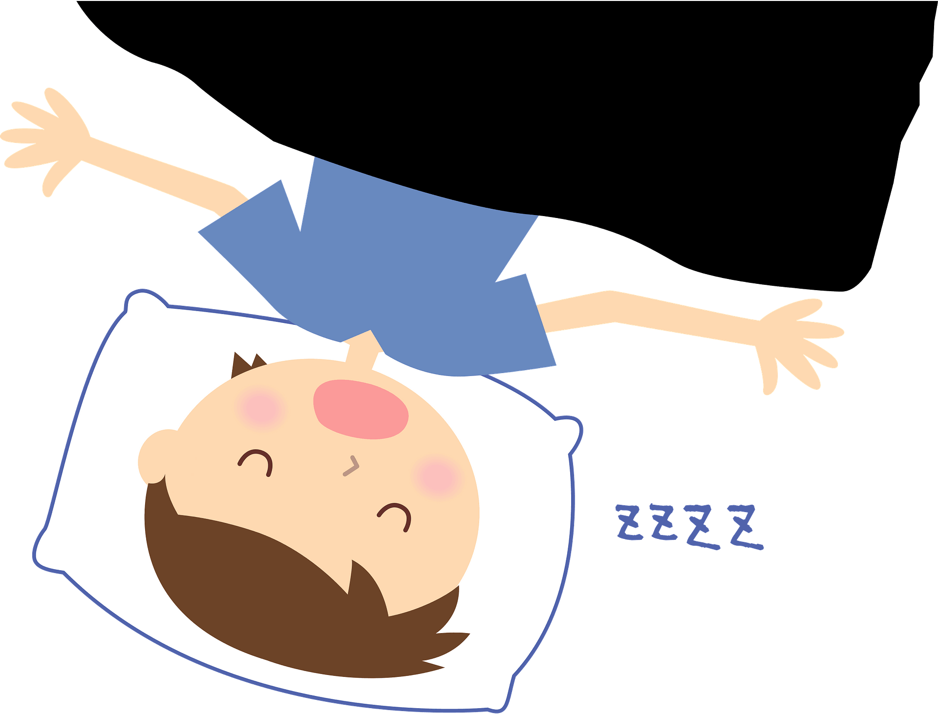
Why is the topic important?
This topic is important because sleep is an essential part of your body. Sleep helps support growth for teenagers and children, but it’s also essential for adults. It helps with decreasing risks for health conditions like:
Heart disease
High blood pressure
Obesity
Strokes
Getting sleep on time is also essential because your body runs on an internal clock called it’s circadian rhythm. If this is disrupted, REM sleep will be negatively affected [nhlbi.gov].
Notes:
https://www.nhlbi.nih.gov/health/sleep/why-sleep-important

Slide 4
Dataset
Questions:
How many children?
What age are your children?
How do digital devices affect sleep?

Slide 5
Data
A variety of things there can be rules for, including:
Parents Alcohol use - Pradeep
Caffeine - Agniva
Phone use
Computer/Tablet use
Games - Lere

Slide 6
Hypothesis

Slide 7
Caffeine Hypothesis - Agniva G.
The prediction for any correlations between caffeine consumption and hours of sleep is: With the increase of caffeine after a certain time period of the day, caffeine's effects will have a negative correlation with hours of sleep.

Slide 8
Alcohol use Hypothesis - Pradeep P.
The greater the amount of alcohol consumed will lead to a lower duration of sleep.

Slide 9
Games Hypothesis - Lere O.
The amount of sleep a person gets will decrease with the amount of time they spend playing games.

Slide 10
Online Time Hypothesis - Ashrit K.
The more someone spends on using his/her technology for their desired amount of time, the less sleep they get.

Slide 11
Methods

Slide 13
Method: Games
I chose to use a scatter plot for graphing because the hypothesis compares two numeric factors, one of them being time which scatter plots are especially good for.

Slide 14
Methods - Pradeep Prakash
Due to the correlation between amount of alcohol consumed and number of hours each participant slept I chose to use a scatter plot with a line of best fit to best represent the correlation between the two variables.

Slide 15
Method: Scatter - Plot.
The two numerical data values were the amount of time people spend on digital screens, 1 is the most amount of digital screen time, 4 is the least. The second one is the amount of time people sleep for which is represented in hours. Therefore we
Since the scale

Slide 16
Analysis

Slide 21
Results

Slide 26
Conclusion

